Slide 1
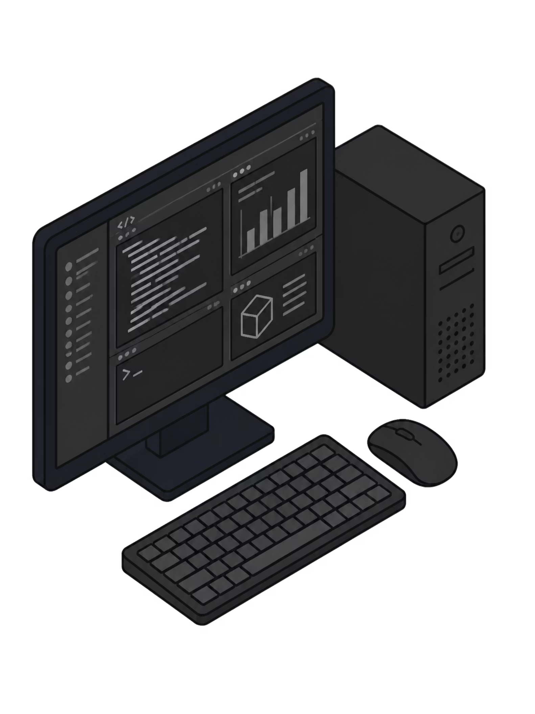
Smart Workload Manager
An Intelligent System for Optimizing Running Applications
DEPARTMENT OF COMPUTER SCIENCE & ENGINEERING
Team Members:
Pavithra
2510030271
Snikitha Sree
2510030305
Anusha
2510030174
Lathika
2510030252

Slide 2

Introduction
Modern computers often run multiple applications simultaneously. During important tasks such as studying, coding, attending online classes, or presentations, background applications may consume unnecessary system resources.
Although operating systems manage these resources automatically, users often experience slow performance because they must manually identify and manage resource-intensive applications.
Our project aims to provide a smarter way to monitor and manage running applications based on the user's current activity.

Slide 3

Problem Statement
Users frequently run multiple applications at the same time, such as browsers, IDEs, media players, and background services.
This may lead to:
Slow system performance
High CPU and memory usage
Reduced responsiveness of important applications
Difficulty identifying which application is causing the slowdown
Manual effort required to optimize running applications

Slide 4
Existing System
What Current Tools Offer
Limitations
Current tools like Task Manager and System Monitor allow users to:
They mainly provide monitoring information
Users must manually decide what action to take
No workload-based assistance
No user-specific optimization suggestions
View running processes
Monitor CPU usage
Monitor memory usage
End unwanted tasks manually

Slide 5
Proposed System
Smart Workload Manager is a system that continuously observes running applications and helps users manage system workload more effectively.
The proposed system will:
Monitor
Analyze
Identify
Monitor running applications in real time
Analyze CPU and memory usage
Identify resource-intensive applications
Suggest
Log
Suggest possible optimization actions
Maintain activity logs

Slide 6


Objectives
1
2
3
Monitor Applications
Understand Usage
Reduce Waste
Develop a system to monitor running applications
Help users understand system resource usage
Reduce unnecessary resource consumption
4
5
Improve Responsiveness
Build Foundation
Improve overall system responsiveness
Provide a foundation for intelligent workload management

Slide 7





Proposed Modules
Module 1 – Process Monitor
Module 2 – Resource Monitor
Module 3 – Analysis Module
Displays currently running applications
Displays CPU and memory usage
Identifies applications consuming high resources
Module 4 – Suggestion Module
Module 5 – Activity Logger
Recommends actions for improving performance
Maintains logs of system activity and recommendations

Slide 8
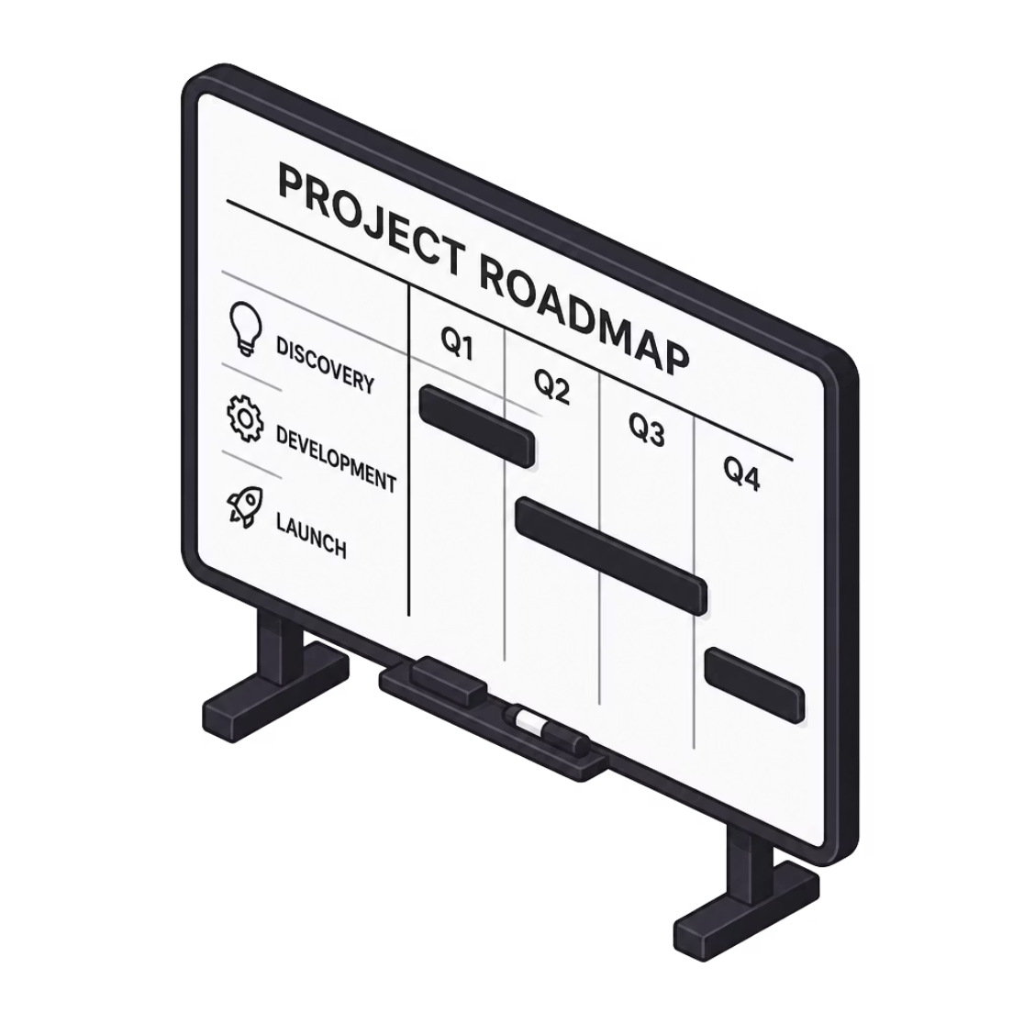
Development Plan
01
02
Review 1
Review 2
Problem identification, Requirement analysis, Literature survey, System design
Process monitoring, Resource monitoring
03
04
Review 3
Review 4
Analysis module, Logging system
Smart recommendation module
05
Final Review
Integration, Testing, Documentation, Demonstration

Slide 9
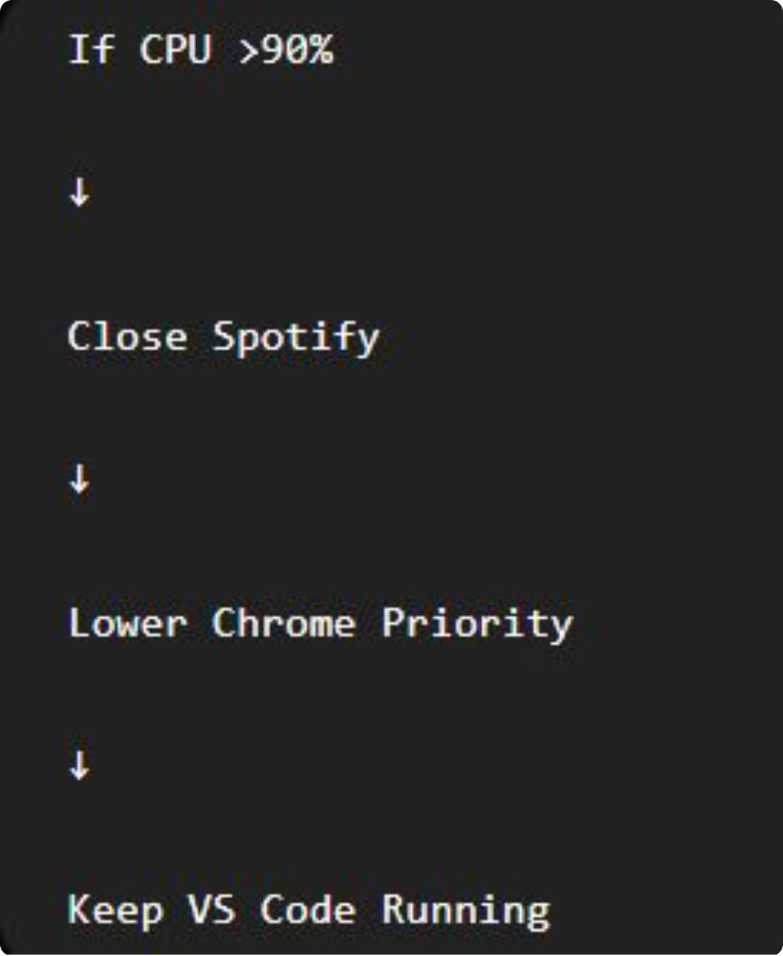
Expected Outcome
Balanced workload distribution.
Better CPU utilization.
Reduced processing time.
Real-time monitoring of tasks.
Improved overall system performance.
Easy visualization of task execution.

Slide 10
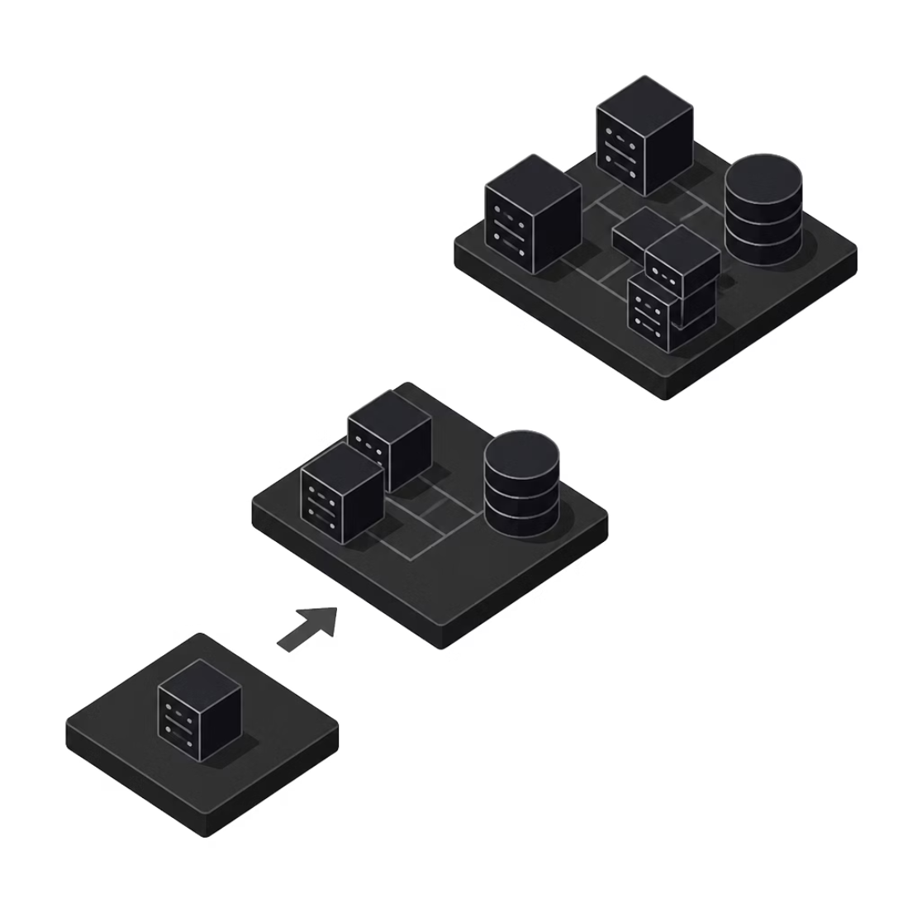
Conclusion
Smart Workload Manager aims to improve the way users monitor and manage running applications.
The project begins with basic monitoring and analysis and will gradually evolve into a more intelligent workload management system as additional Operating Systems concepts are learned during the semester.

Slide 11
Thank You

